Slide 1
Pokémon : Gen 1 gotta graph em all
Ian Arch, Paige Breyfogle, Daniel Buescher, Andrew Stepanek
Ya know.. Instead of catch em all… oof tough crowd

Slide 2
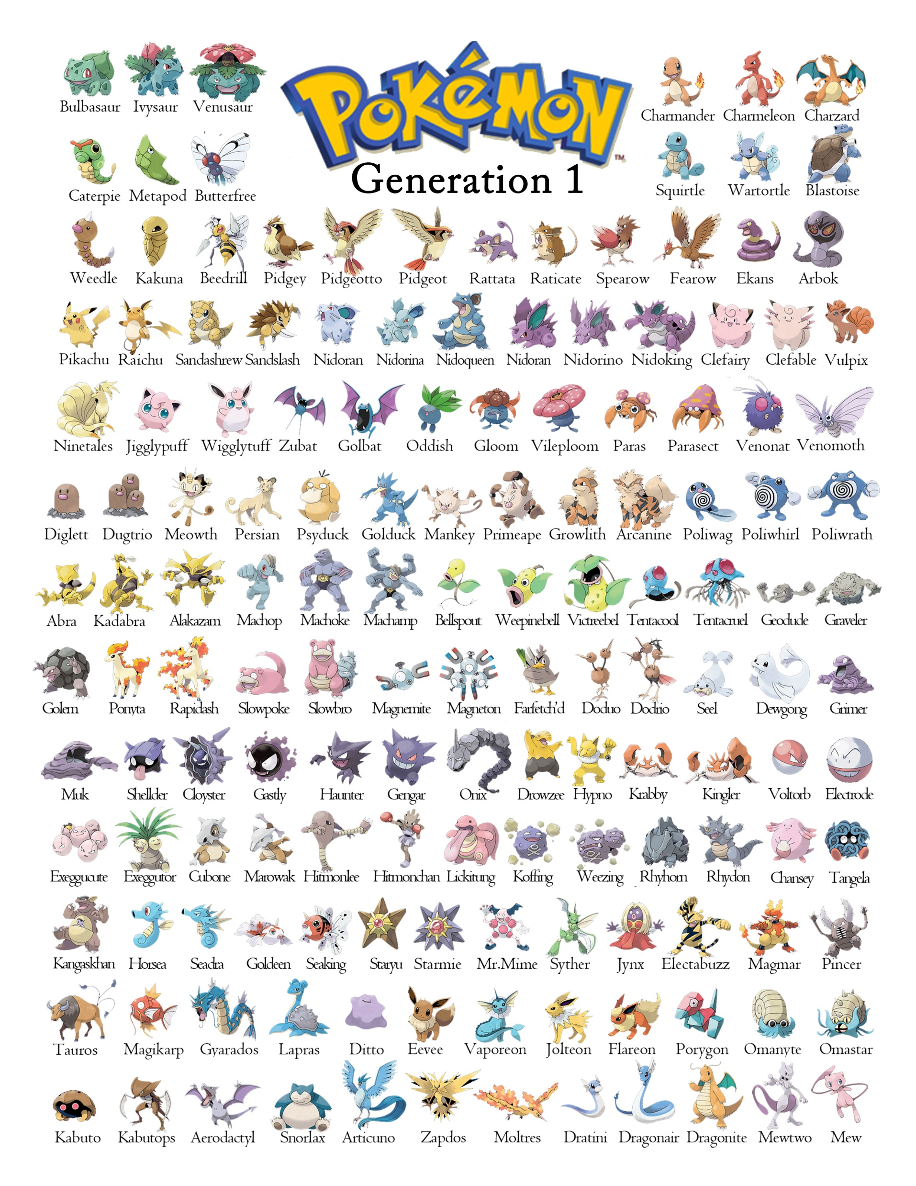
Theme
The topic that we have chosen is Pokemon, the reason we have chose this topic is the nostalgia factor because of Pokémon's prominence in our childhood, as well as educating the current youth on the Original (OG) Gen 1 Pokémon.

Slide 3
Coding approach/ how we did it
https://pokeapi.co/to pull data in ; data was raw and extremely broad
Filtered data down to make it more workable/useable
Used jupyter notebook to convert data into a data frame,
Postgres to store and sort through data

Slide 5
Final Visulation
We wanted to have graphic representation of the different stats and incorporate some interaction with updates based on the selected Pokémon type.
We broke the data down into the types so it was more visually appealing and easier to digest.
We used a Javascript library not covered in class – this allowed us to do-

